Slide 1
Group B
Group Members : 劉洮語、黃啟瑞、彭煜博

Slide 2





Introduction
Topic : Online banking system
Goal : We wish to successfully make a system that is available to all the service you can do in a bank, like loan, money transference, credit card application, etc.

Slide 3
Requirement
Our customer want a more efficient and comfortable environment to do things they want to do in a bank, in a physical store, they may need to stand in line and that is really a waste of time, and they also require a online personal service in case of they meet complicated problems they need an expert to make them easily get into the situation.

Slide 4
User View
Money Transference
Loan
Credit Card Application
View account balance
Password Change
Pay Bills(Taxes、Fees)
Investment Management
Support Mobile Payment
Online Dedicated Services

Slide 5
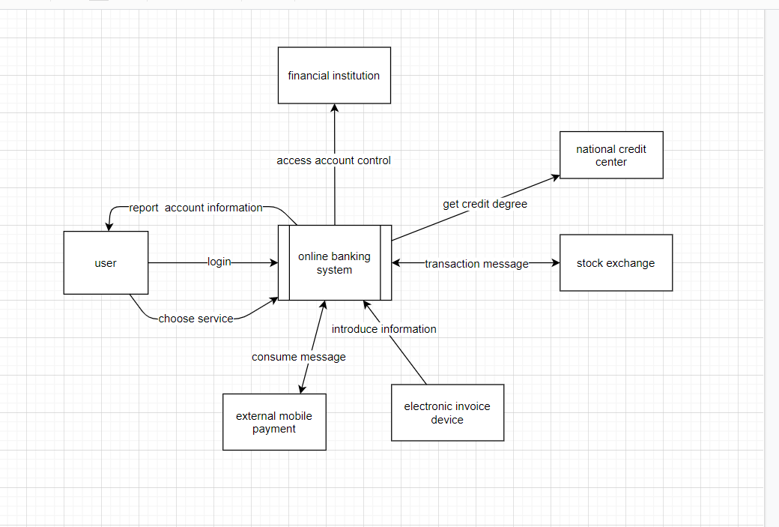
Data Flow Diagram Level 0
Environment Diagram

Slide 6
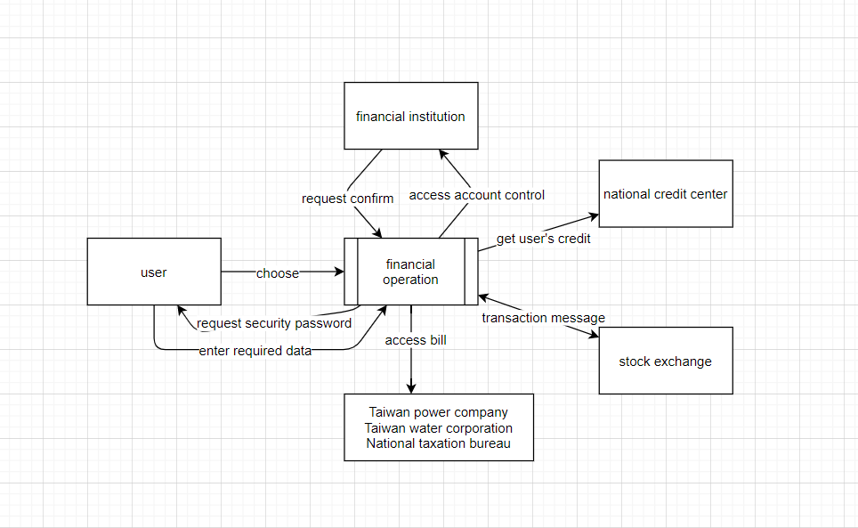
Data Flow Diagram Level 1
Financial Operation

Slide 7
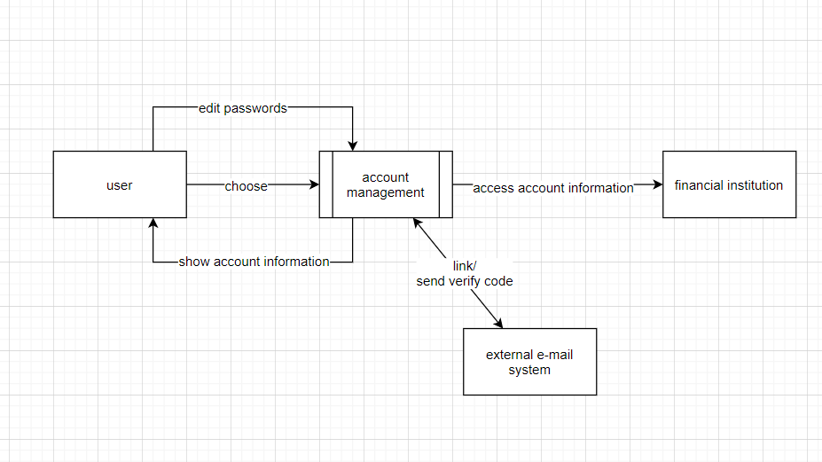
Data Flow Diagram Level 1
Account Management

Slide 8
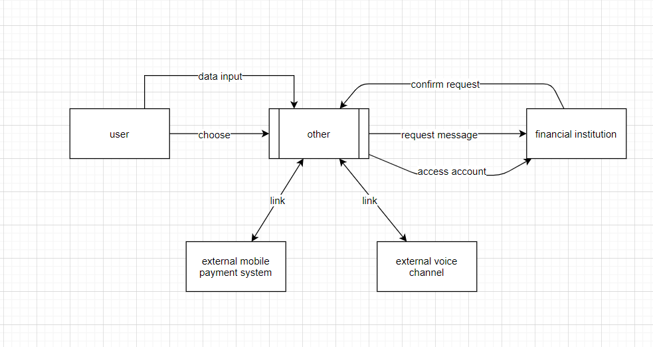
Data Flow Diagram Level 1
Other :

Slide 9
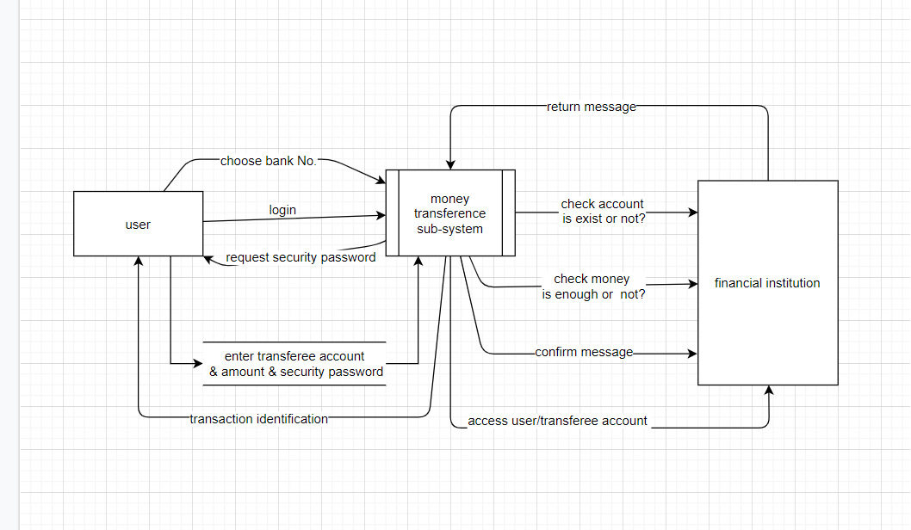
Data Flow Diagram Level 2
Money Transference :

Slide 10
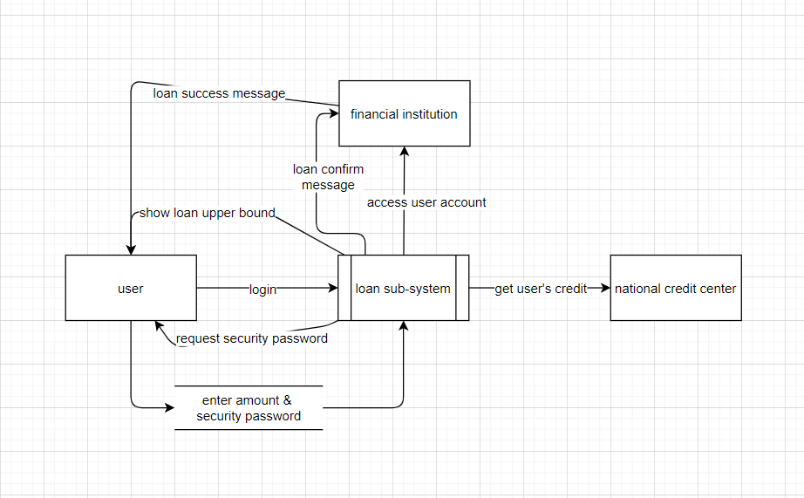
Data Flow Diagram Level 2
Loan :

Slide 11
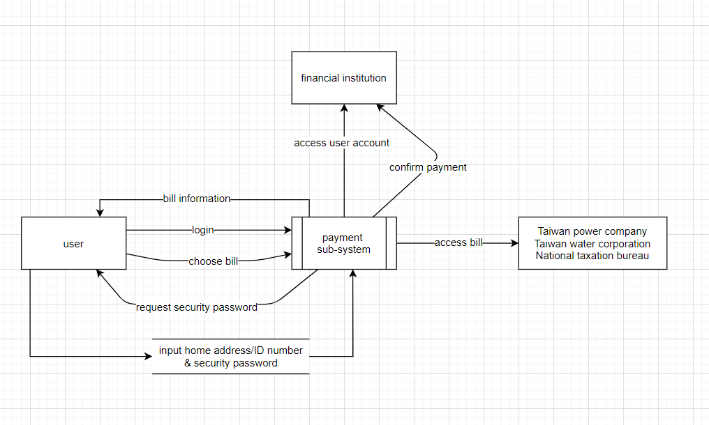
Data Flow Diagram Level 2
Bill Payment System :

Slide 12
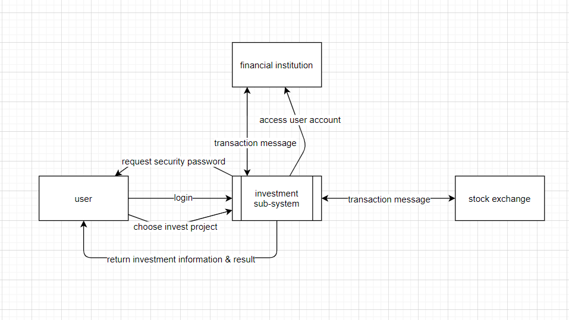
Data Flow Diagram Level 2
Investment System :

Slide 13
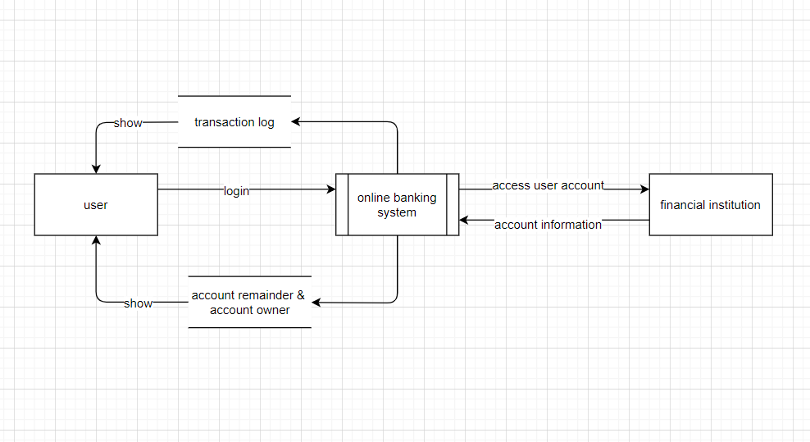
Data Flow Diagram Level 2
View Account Information :

Slide 14
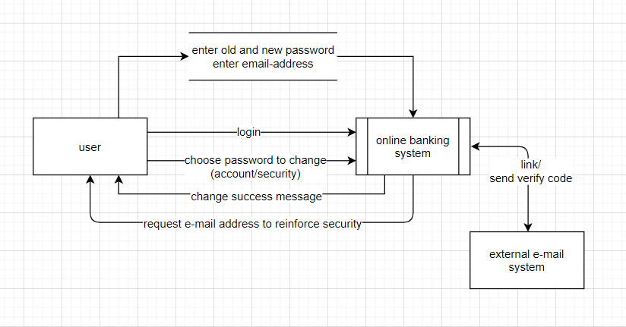
Data Flow Diagram Level 2
Security :

Slide 15
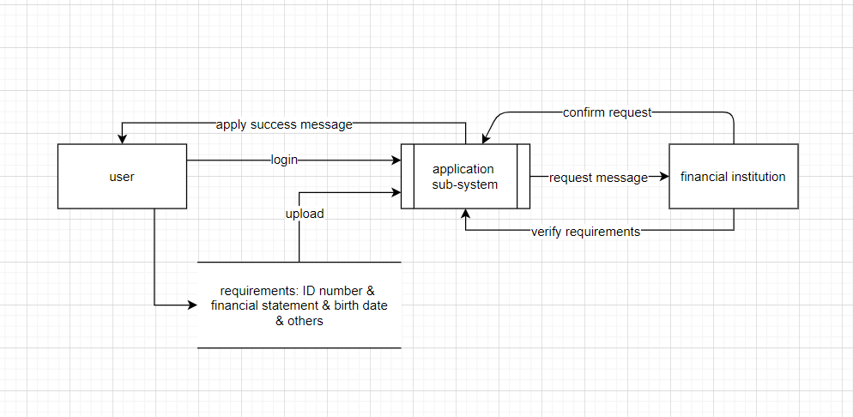
Data Flow Diagram Level 2
Application System :

Slide 16
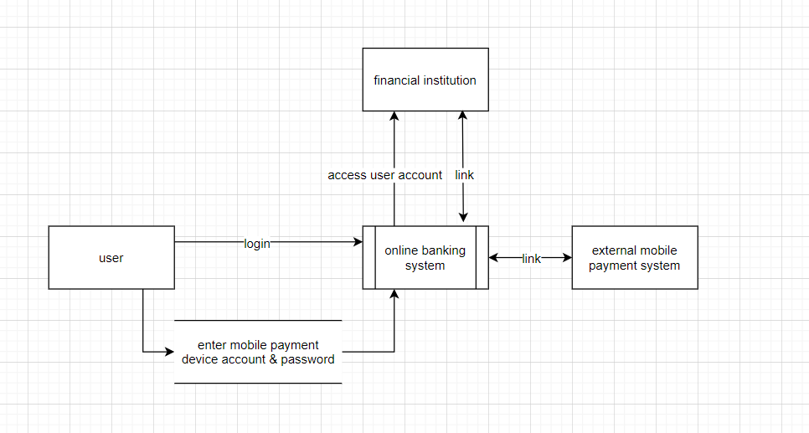
Data Flow Diagram Level 2
Support Mobile Payment :

Slide 17
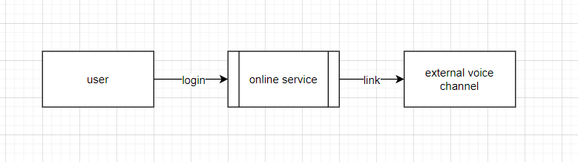
Data Flow Diagram Level 2
Online Customer Services :

Slide 18
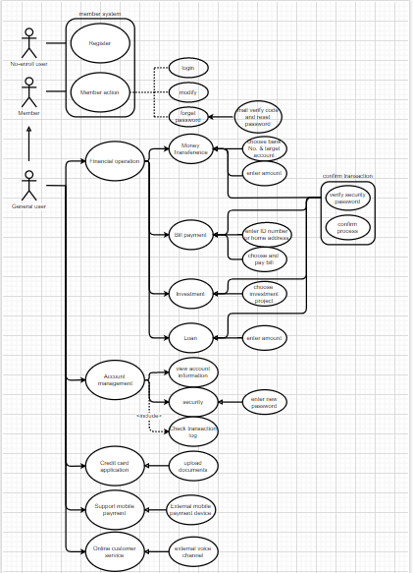
Use Case Diagram

Slide 19
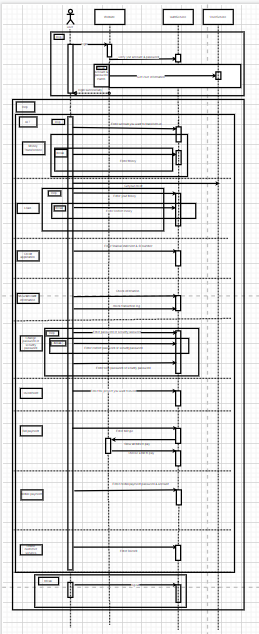
Sequential Diagram

Slide 20
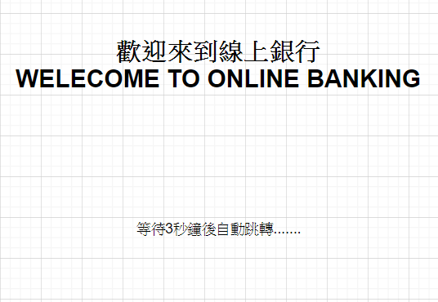
GUI Image --- Start

Slide 21
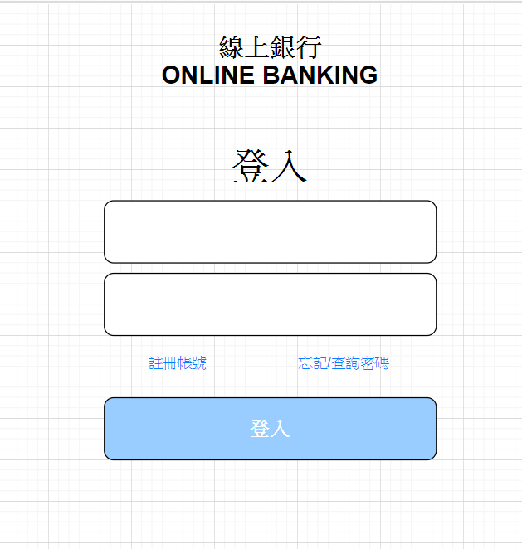
GUI Image --- Log in

Slide 22
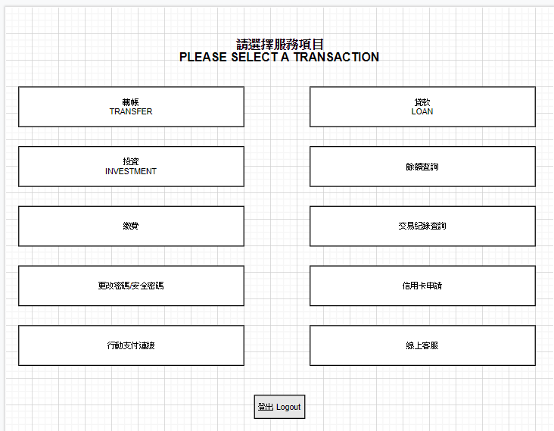
GUI Image --- Function choose

Slide 23
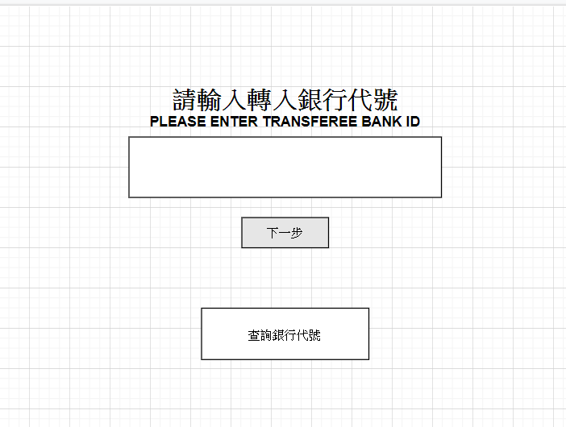
GUI Image --- Money transference

Slide 24
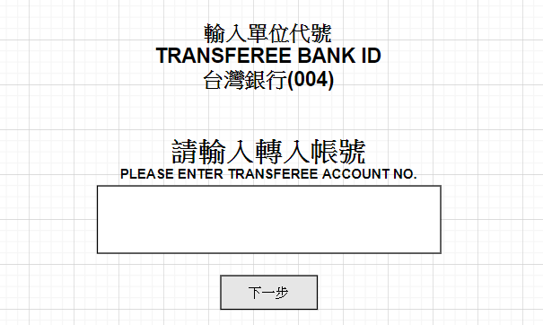
GUI Image --- Money transference

Slide 25
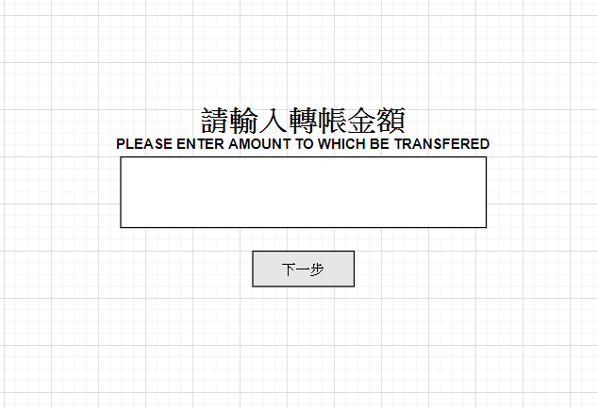
GUI Image --- Money transference

Slide 26
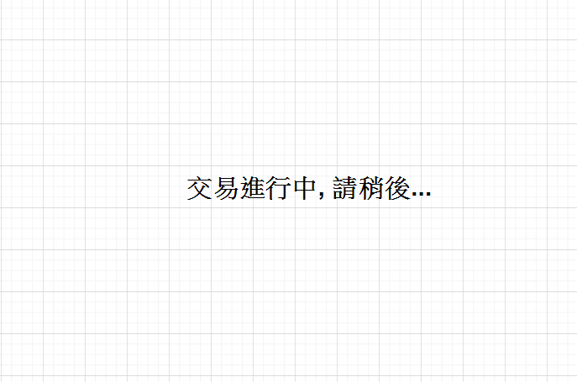
GUI Image --- Money transference

Slide 27
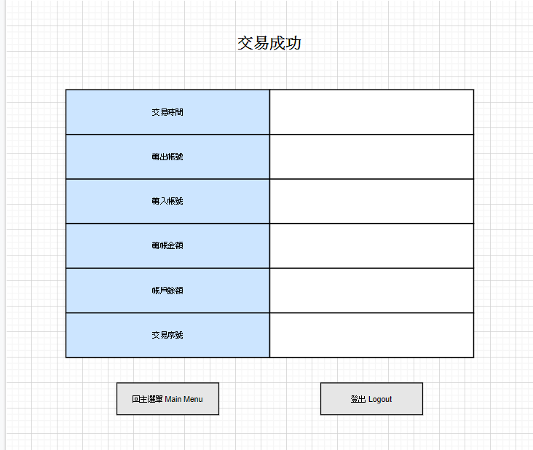
GUI Image --- Money transference

Slide 28
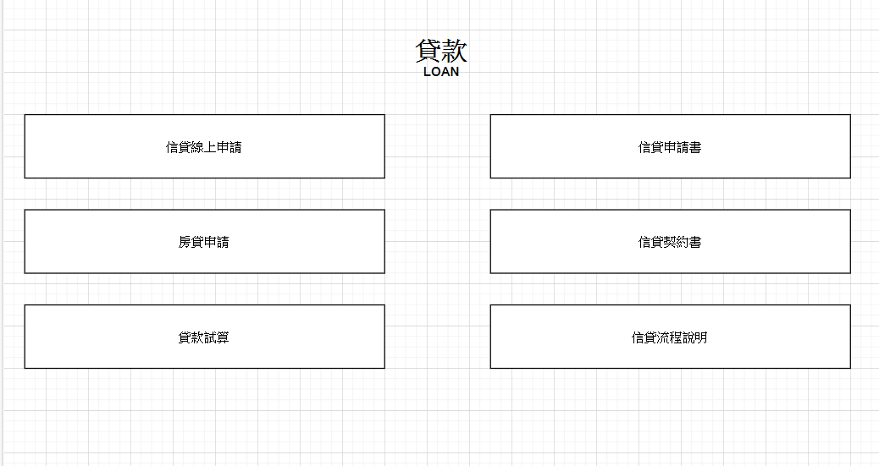
GUI Image --- Loan

Slide 29
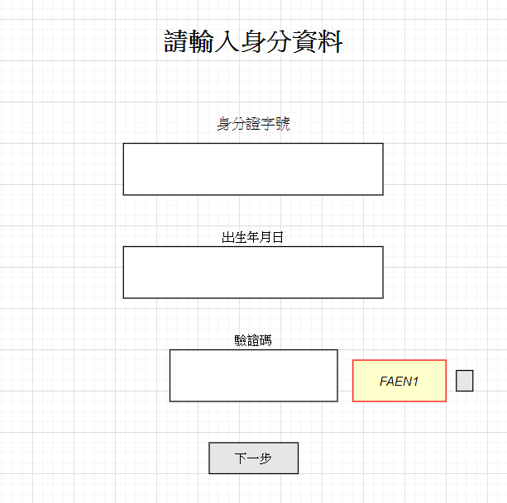
GUI Image --- Loan

Slide 30
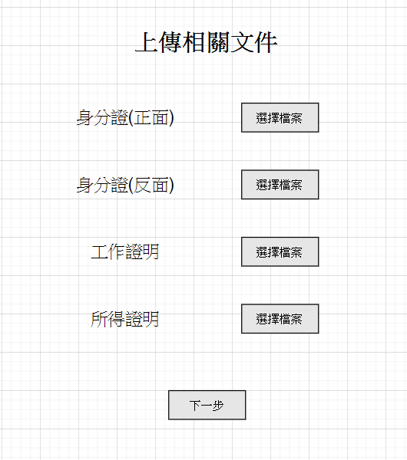
GUI Image --- Loan

Slide 31
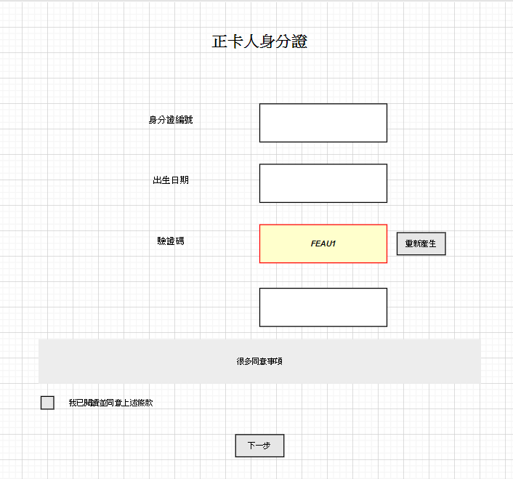
GUI Image --- Credit Card Application

Slide 32
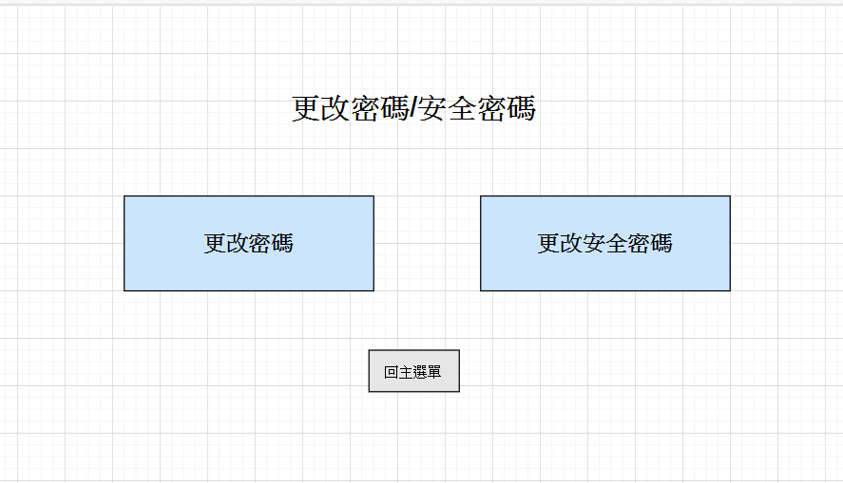
GUI Image --- Password Change

Slide 33
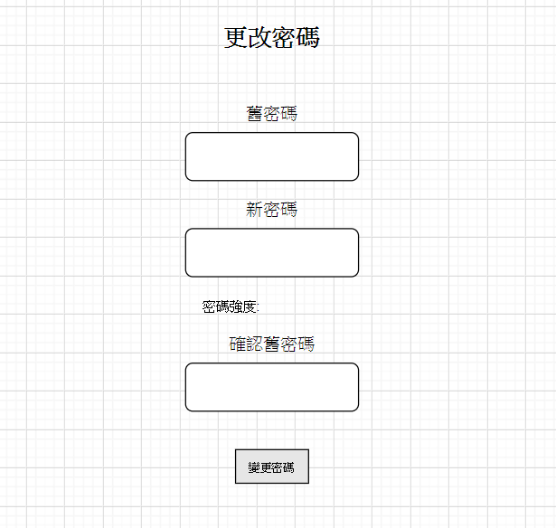
GUI Image --- Password Change

Slide 34
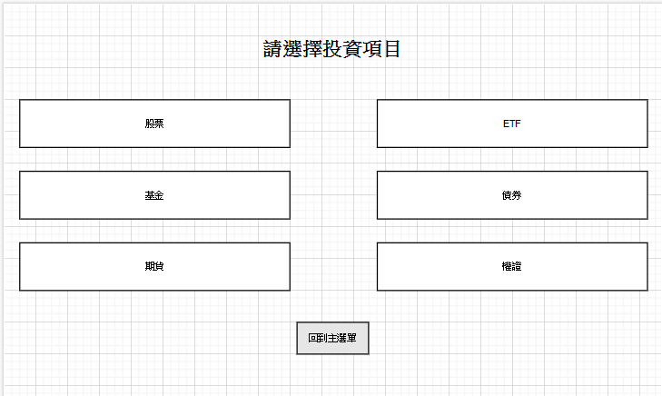
GUI Image --- Investment Management

Slide 35
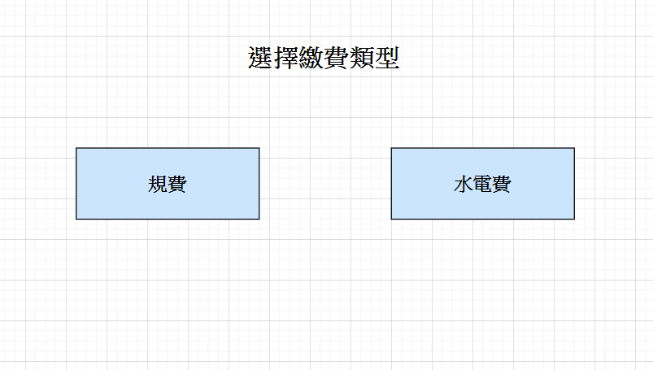
GUI Image --- Pay Bill

Slide 36
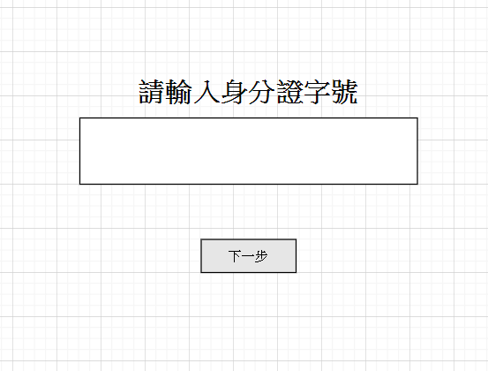
GUI Image --- Pay Bill

Slide 37
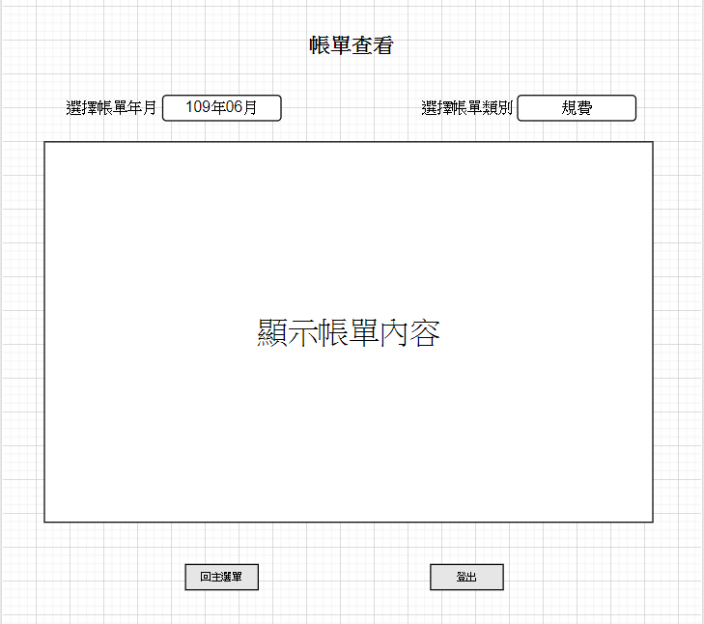
GUI Image --- Pay Bill

Slide 38
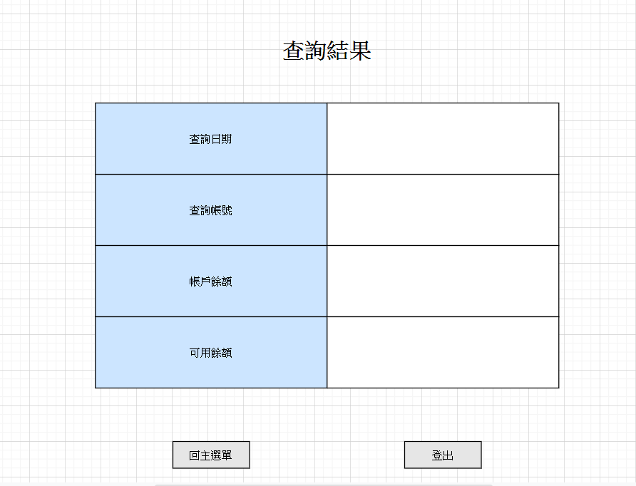
GUI Image --- View Account Information

Slide 39
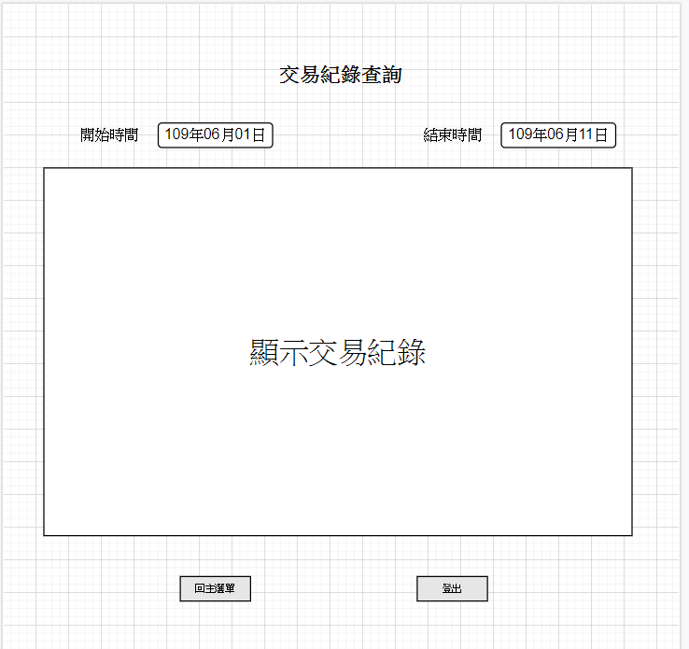
GUI Image --- View Account Information

Slide 40
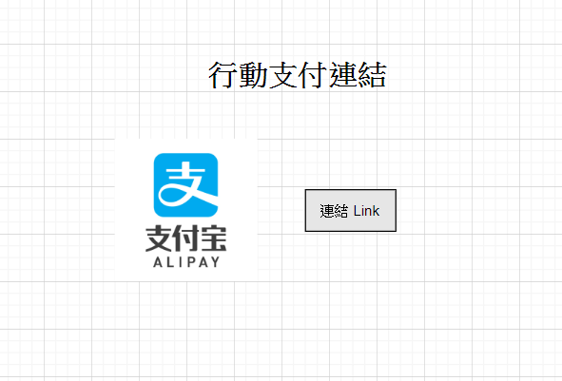
GUI Image --- Support Mobile Payment

Slide 41
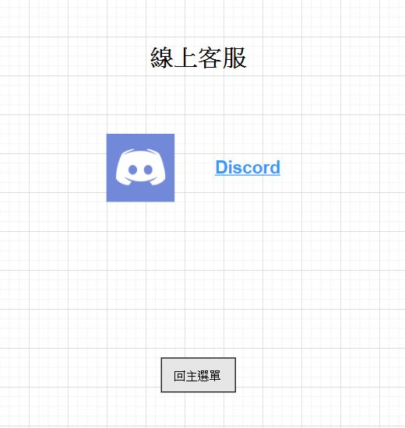
GUI Image --- Online Customer Services

Slide 42
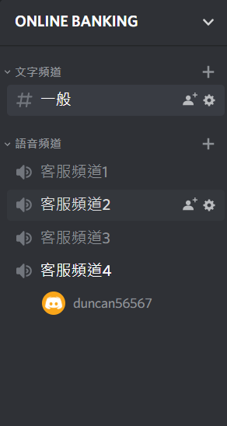
GUI Image --- Online Customer Services

Slide 43
Cost for Design
We assume that our code will take approximately 150000 lines, our calculation will be:
Effort = 2.4(KLOC)^1.05 = 462.5PMs
Time = 2.5(Effort)^0.38 = 25.7Ms

Slide 44
Summary
Finally , we successfully create a system that can satisfy our customer’s expectation, we can make customer do money transference online instead of going to a Physical Store, it is definitely a more efficient way !
Match
Customer
Our Design

